Slide 1

Data Science Project
Theme : Safe Driving
Traffic Sign Classification
Presentated by Faouzi TIRA & Mohamed Said CHBINOU

Slide 2
Project Understanding

Slide 3
01
Train and classify Traffic Signs using Convolutional neural networks.
Traffic Sign Classification
02
Train on traffic signs with over 35000 images of 43 different classes with the help of tensorflow and keras .
03
This will be done using OPENCV in real time using a simple webcam .

Slide 4
Data Understanding

Slide 5


Data Shape
34799
Image
of
42 classes
Test
20%
15%
Validation
Train
3
32
65%
32

Slide 6

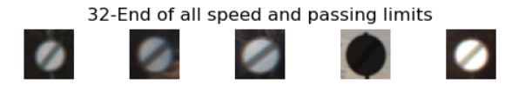



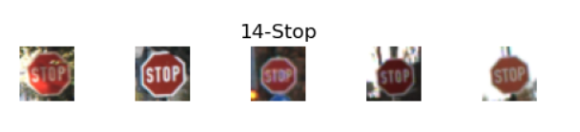


Image Classes Examples :

Slide 7
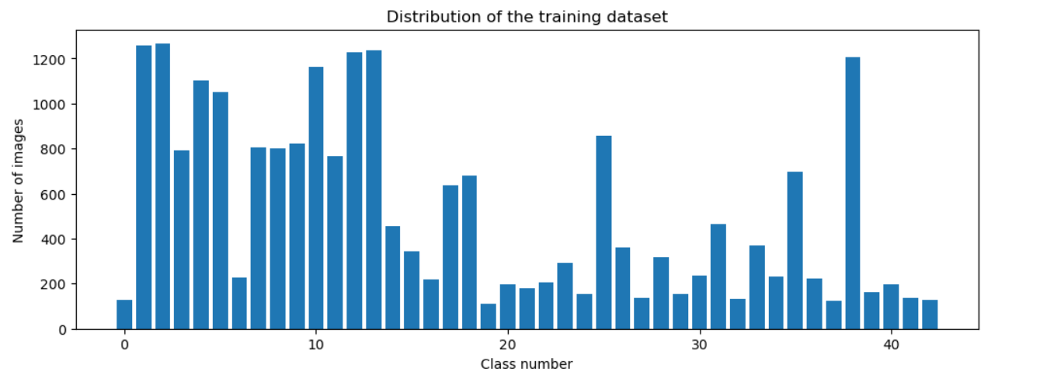
Data Distribution

Slide 8
Data
Preparation

Slide 9
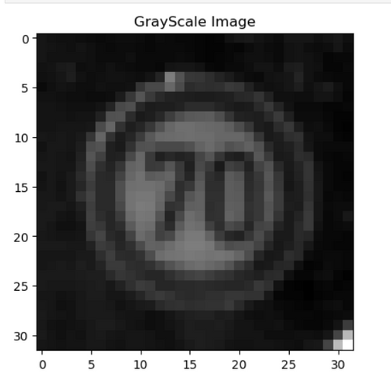

01
GrayScale : Convert images to grayscale for uniformity.
02
Equalize : Enhance contrast by equalizing the histogram of color channels.
Image Processing
03
Pre-processing : Standardize pixel values between 0 and 1.
04
Augmentation : increase the diversity of the training dataset by applying various transformations to the existing images.

Slide 10
Modeling

Slide 11
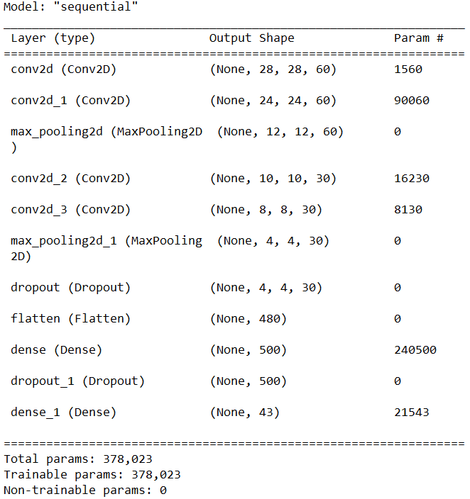
CNN
Model

Slide 12
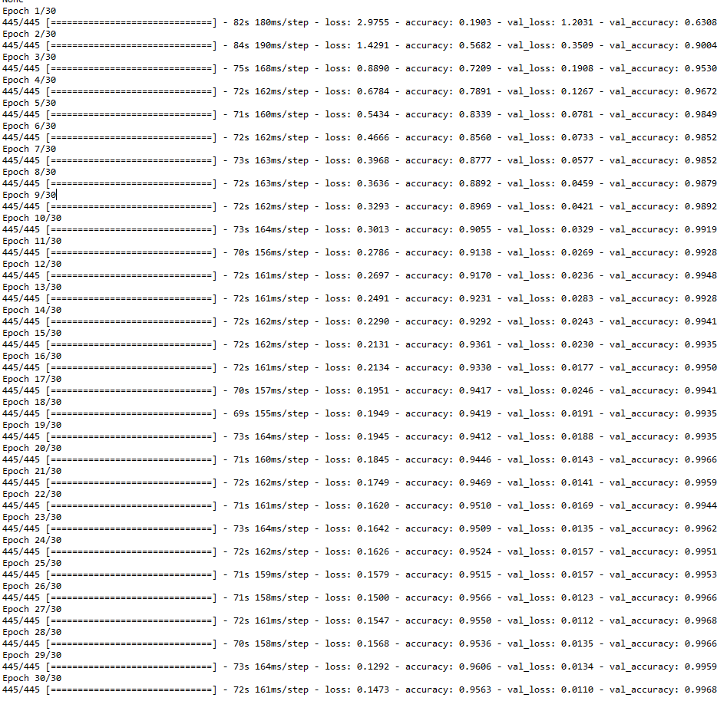

Training

Slide 13
Evaluation

Slide 14
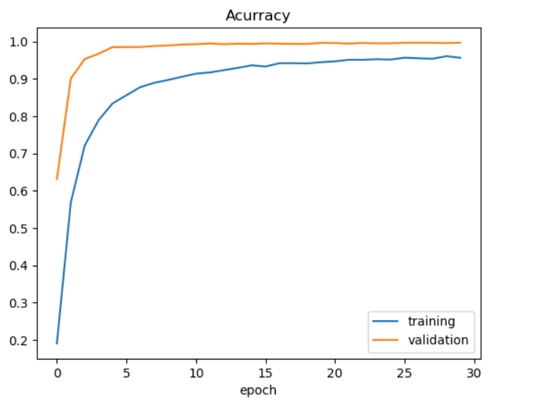
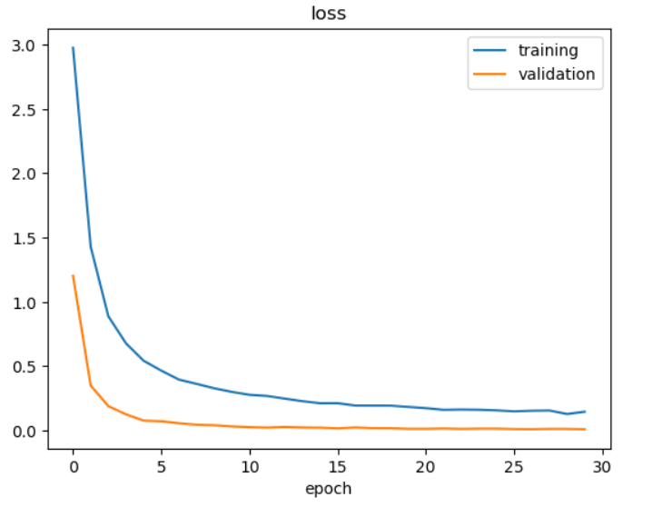
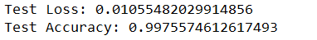

Slide 15
Deployment

Slide 16
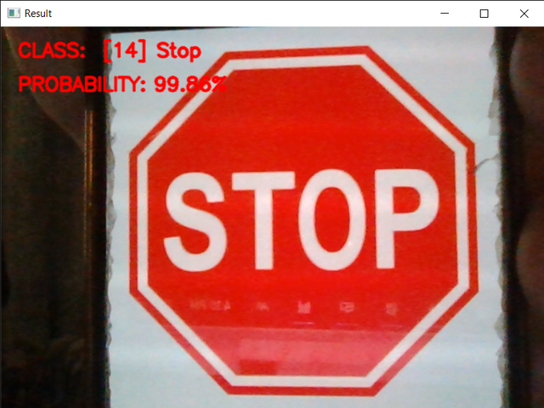
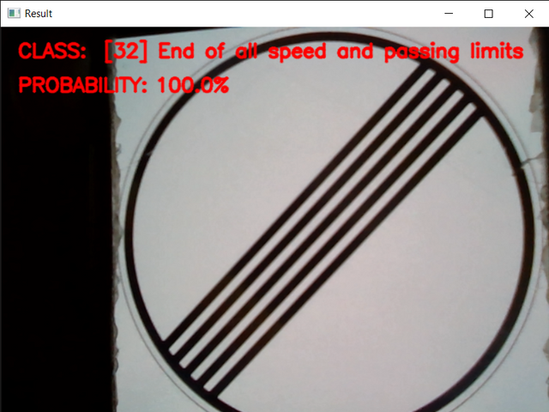
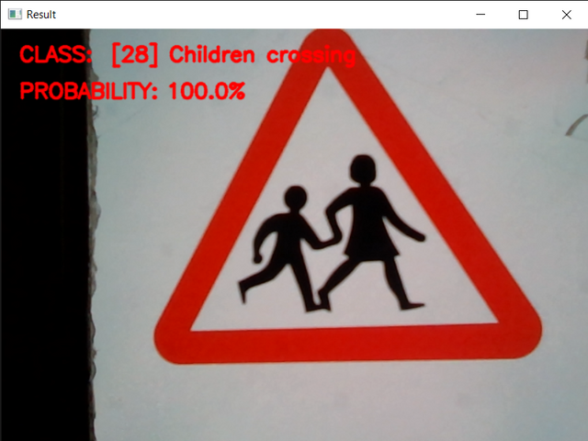
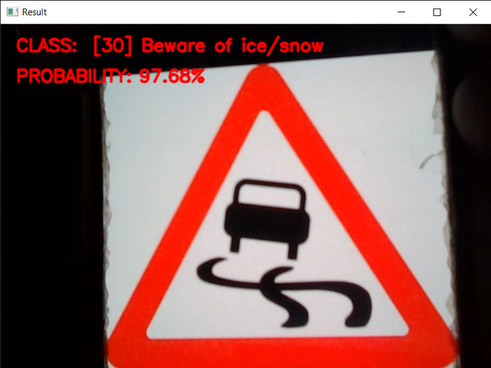
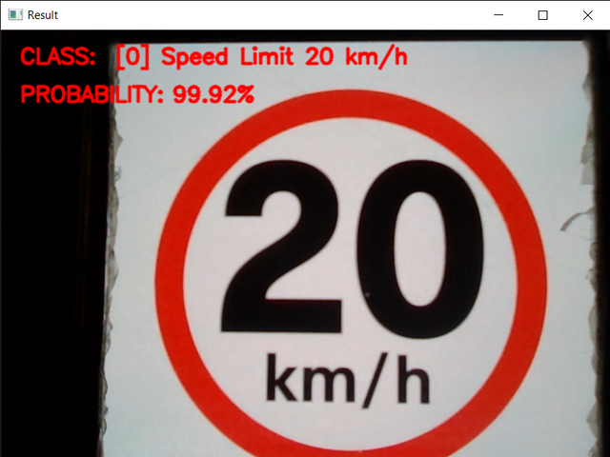
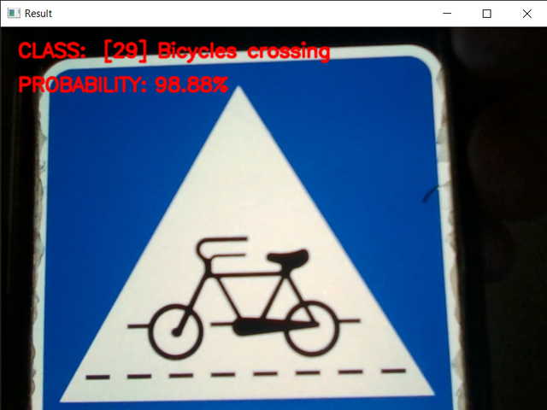

Slide 17
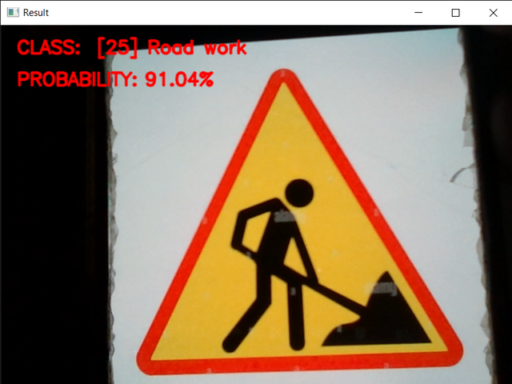
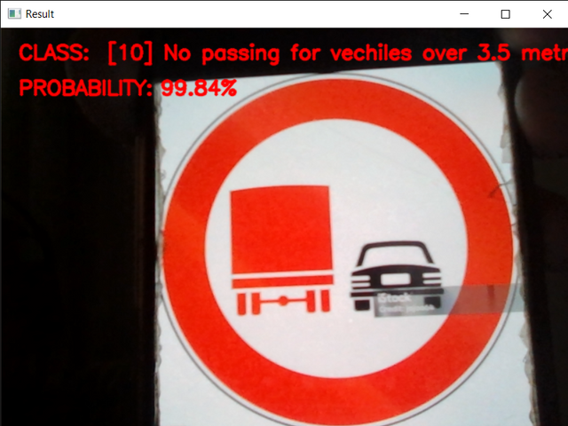
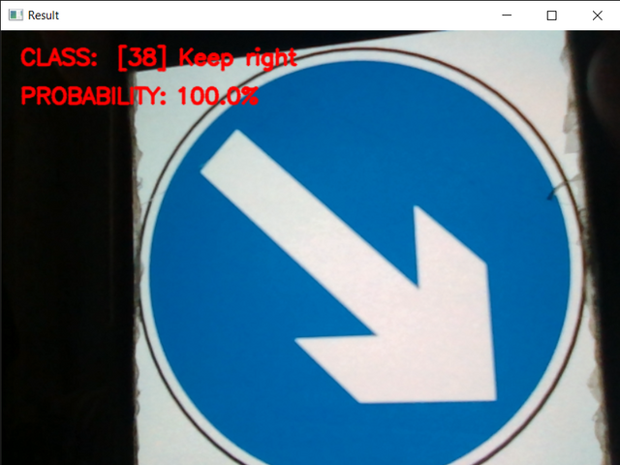
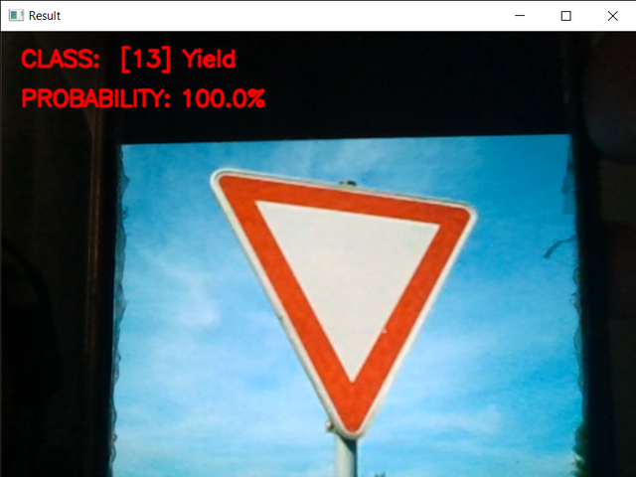

Slide 18
Thank you

